Slide 1

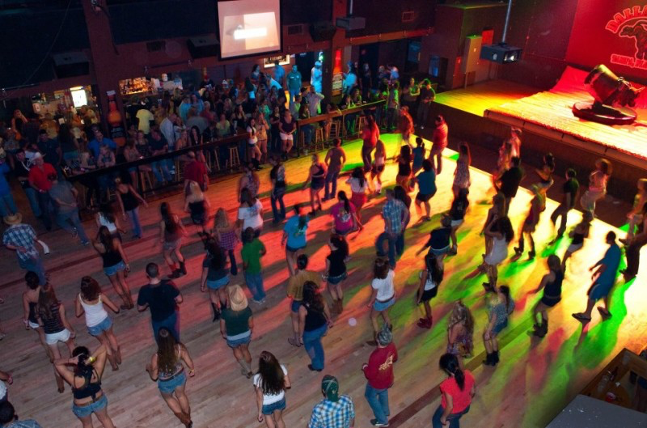
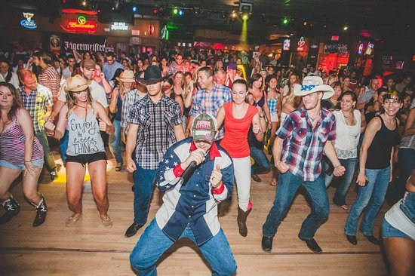
brought to Oxford, MS by:
Davis Brown, Eliza Cannon, Celia Hunt, Halle Johnson, and Allie Moore

Slide 2


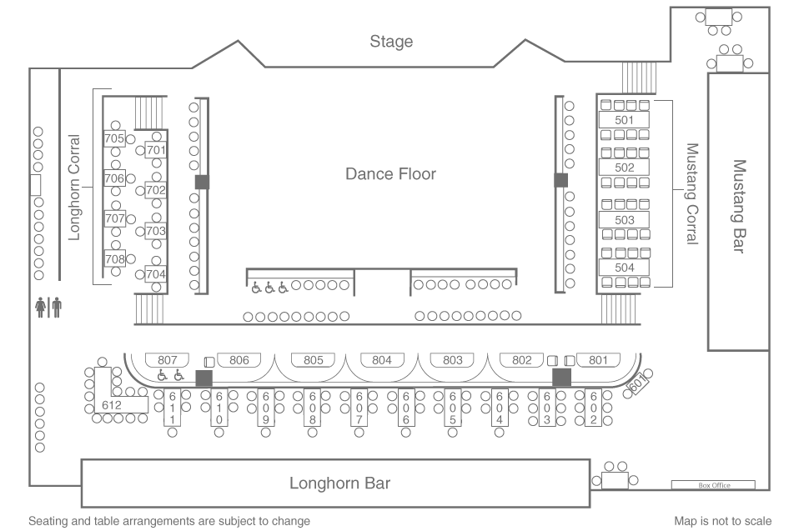
Downstairs:
Mechanical bull
rrrrrrrrrrrrrrrrrrrr
rrrrrrrrrrrrrrrrrrrr
Barrrrrrrr
Barrrrrrrrrrrr

Slide 3
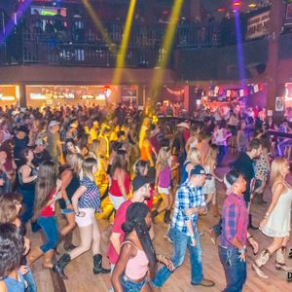
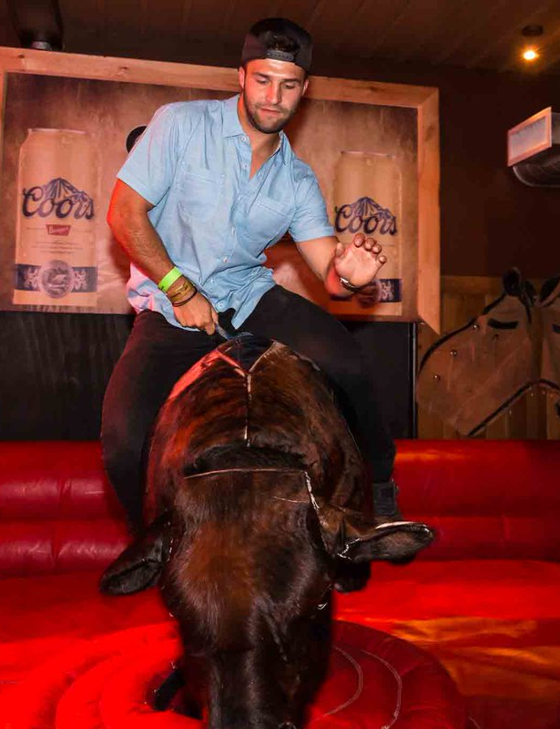
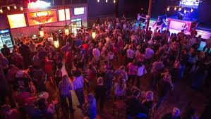
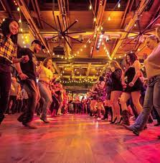
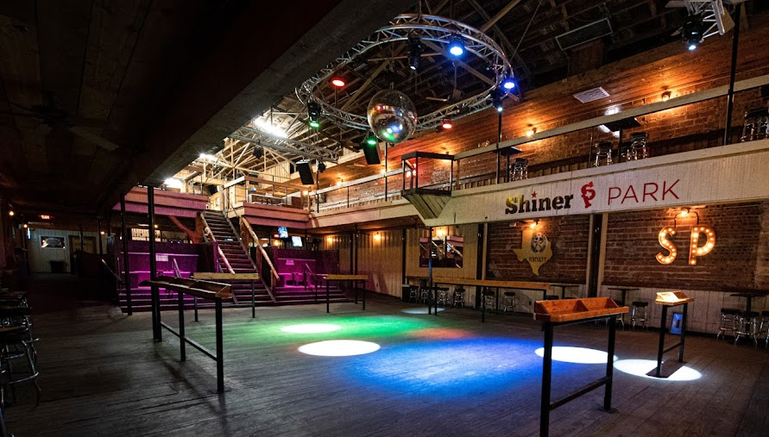

Slide 4
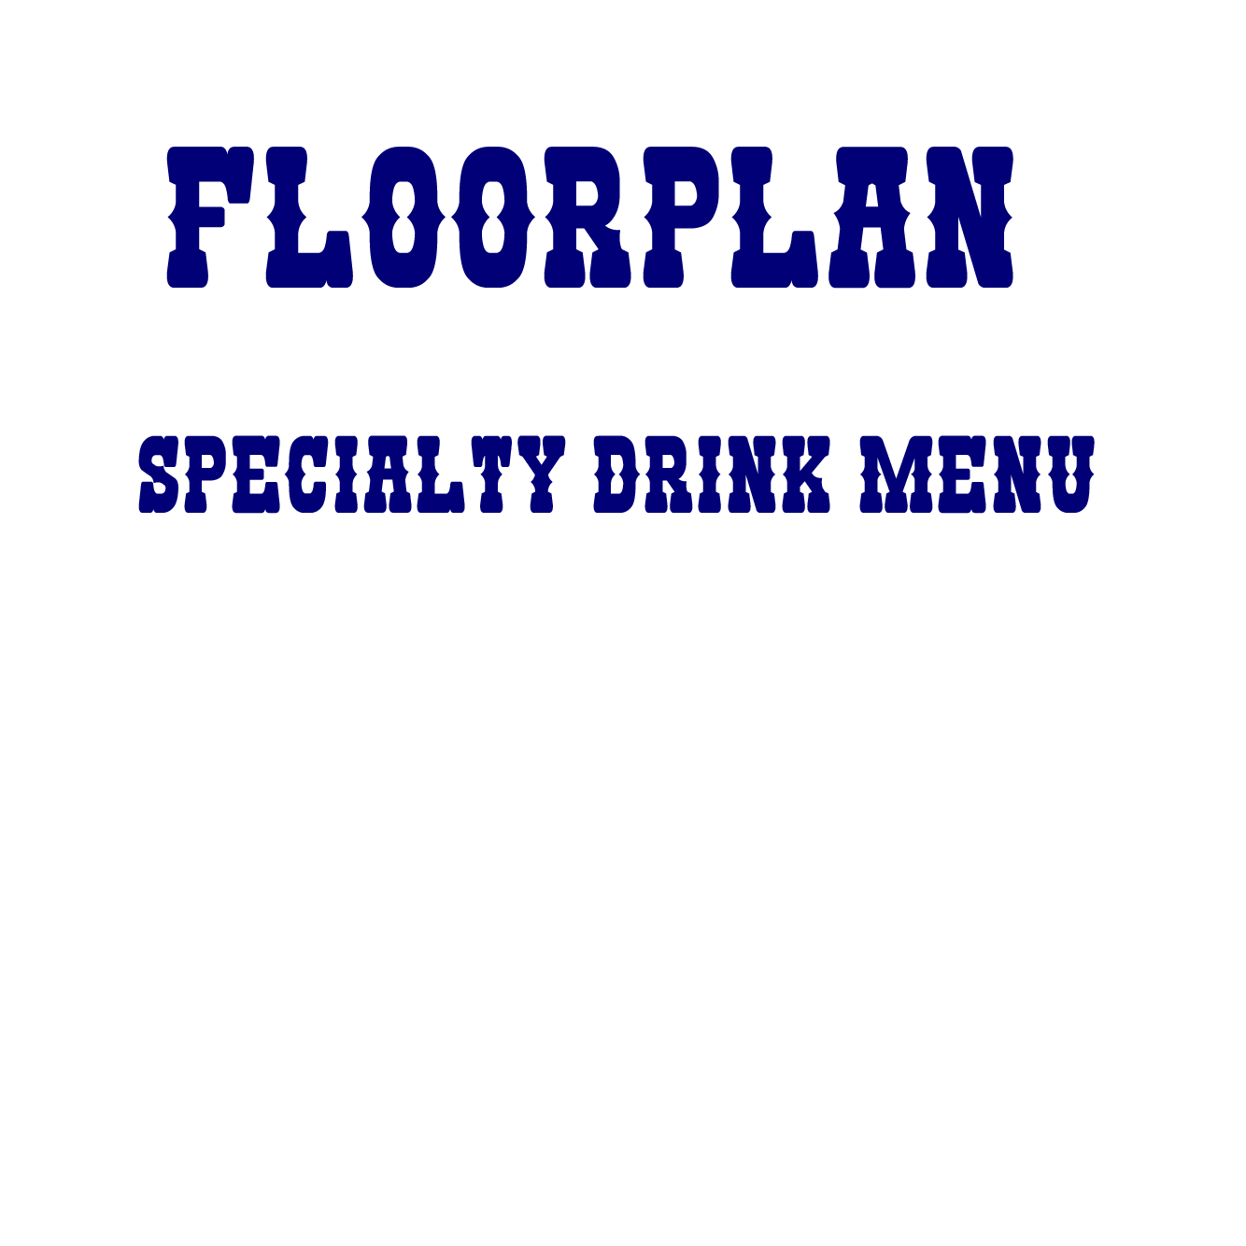
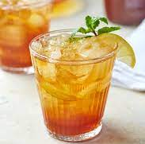
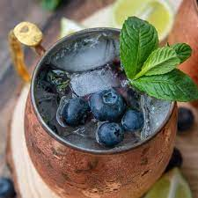
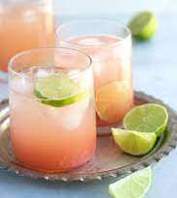
***in addition to a full bar and beers on draft***
JuJu’s Juice (bourbon)
  2 oz Evan Williams Bourbon and sweet or unsweet tea
  (Dr. Welch’s drink)
The Powder Blue - Blueberry Moscow Mule (vodka)
  2 oz blueberry vodka
  1 oz fresh lime juice
  2 tablespoons fresh blueberries
  6 oz ginger beer
  Blue food coloring
The Bull Rider - Grapefruit soda + tequila
  2 oz tequila
  1 oz lime juice
  Grapefruit soda
  Pinch of sea salt

Slide 5
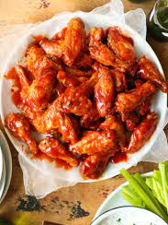
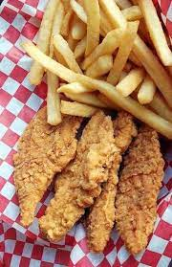

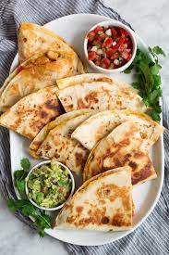
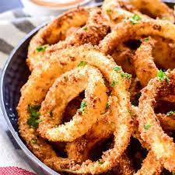
Wings
Chicken Fingers and Fries
Onion Rings
Hotdog
Quesadilla
Grilled Cheese
Loaded Potato Skins
Fried Pickles
Barbeque Nachos

Slide 6

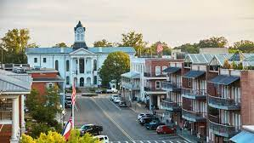
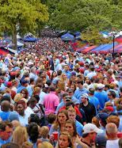
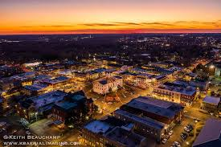
Target Audience: 18-25 year olds
Small Town: gives you something fun to do
Bandwagon of Southern cities
Bringing in revenue/non-oxford locals
Different from your typical bar experience (something Oxford doesn’t have)
Notes:
College kids ---> they are looking for something fun to do, they like going out. 18 year olds get an X on their hand and cover is mandatory for them
Small town: not much to do here. This gives people something different to do other than normal bars, bowling, movie theater or whatever
Most southern cities have a line dancing bar, because people love it down here
Revenue: live music, events, greek life functions, drinks, and cover. As well as, starkville people, tupelo people, and out of town folks coming to see it
Different from just any old bar in oxford. You go to drink but you go to line dance/swing dance

Slide 7

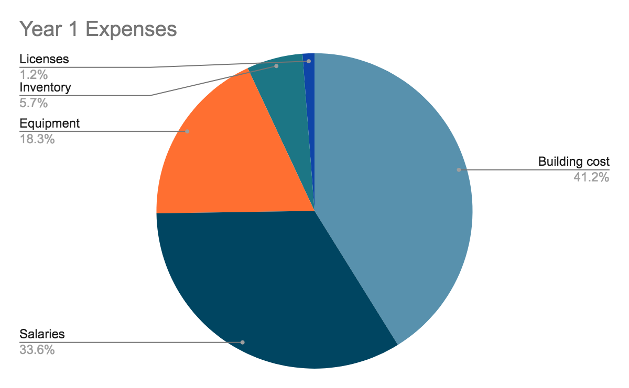
Building cost- $675,000
Equipment- $300,000
Salary- $551,250
Inventory- $94,000
License and Start up fees- $20,000
Total Startup Costs: $1,640,250

Slide 8

-Estimated Startup Costs- $1,640,250
-Projected Profits from Year One- $1,300,000
-79.3% of startup costs made back in year one

Slide 9

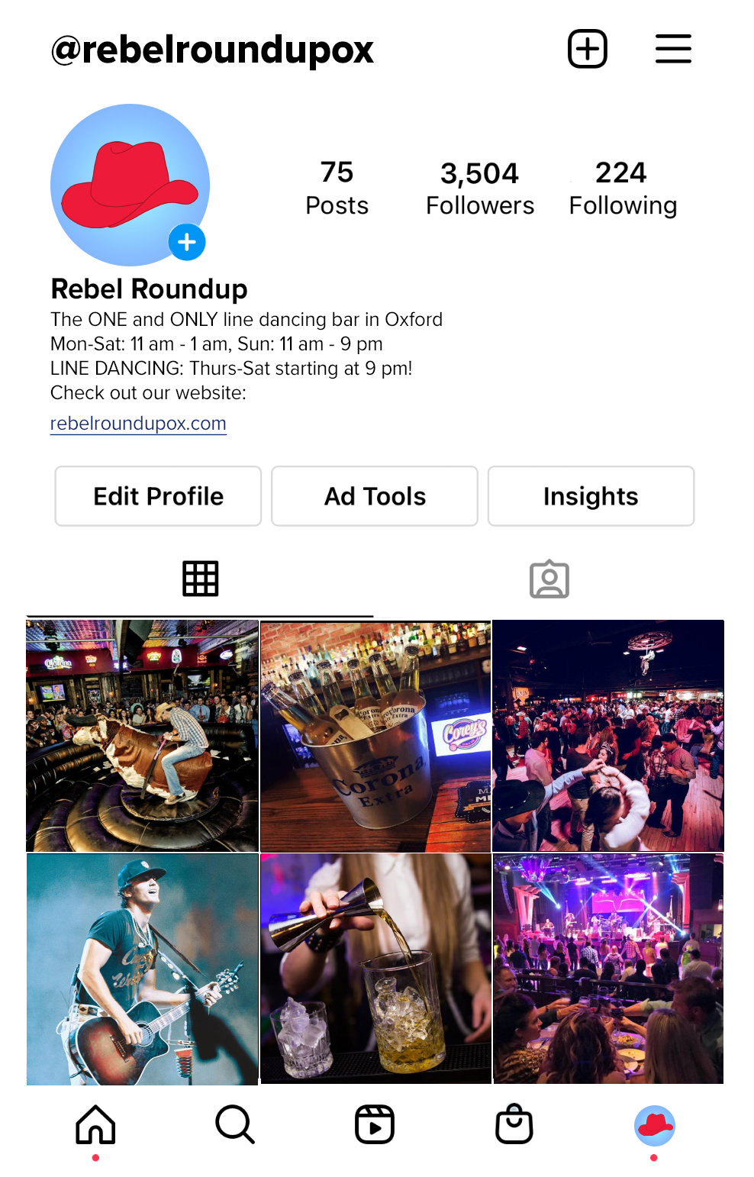
DIGITAL MARKETING
Social Media: Instagram, Tik Tok, Snapchat, Facebook
Website: social media linked, menus, contact, rental request form, calendar
COMPETITION
Availability for rental
Reasonable cover
Different atmosphere

Slide 10
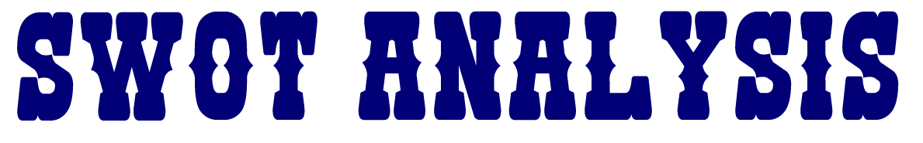
STRENGTHS
Nothing like it in Oxford!
Great way to get friends out together
Great date night spot
Unique drinks that no other bar has
Live music
OPPORTUNITIES
No place in oxford that is actually bar to go dance at besides this one
Fun way for people to learn how to swing and line dance
Event venue (ex: live music/concerts)
WEAKNESSES
This a rare bar experience
Only attracts certain type of people
THREATS
Other bars in Oxford
Some people will see this as a new concept and might not understand

Slide 11
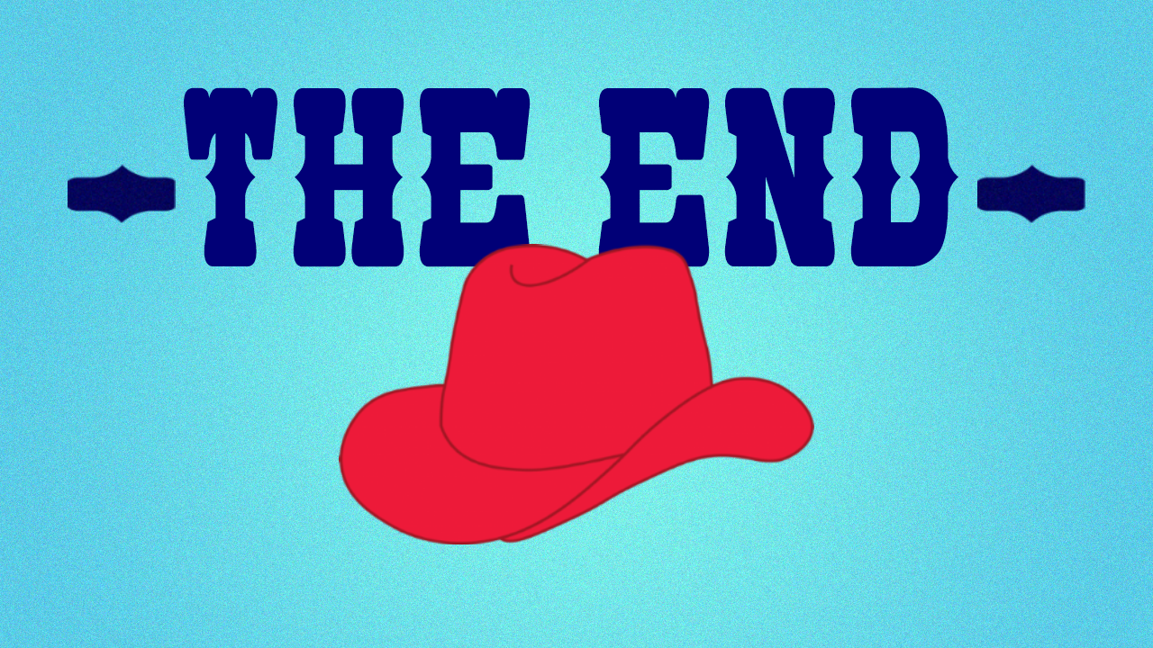
Happy Holidays! Merry Christmas! Have a great break!

