Slide 1


Slide 2

https://projects.invisionapp.com/d/main?origin=v7#/projects/boards/6848704

Slide 3

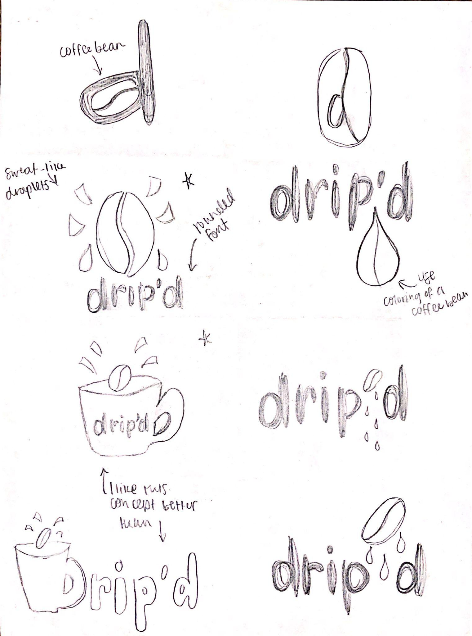



Slide 4

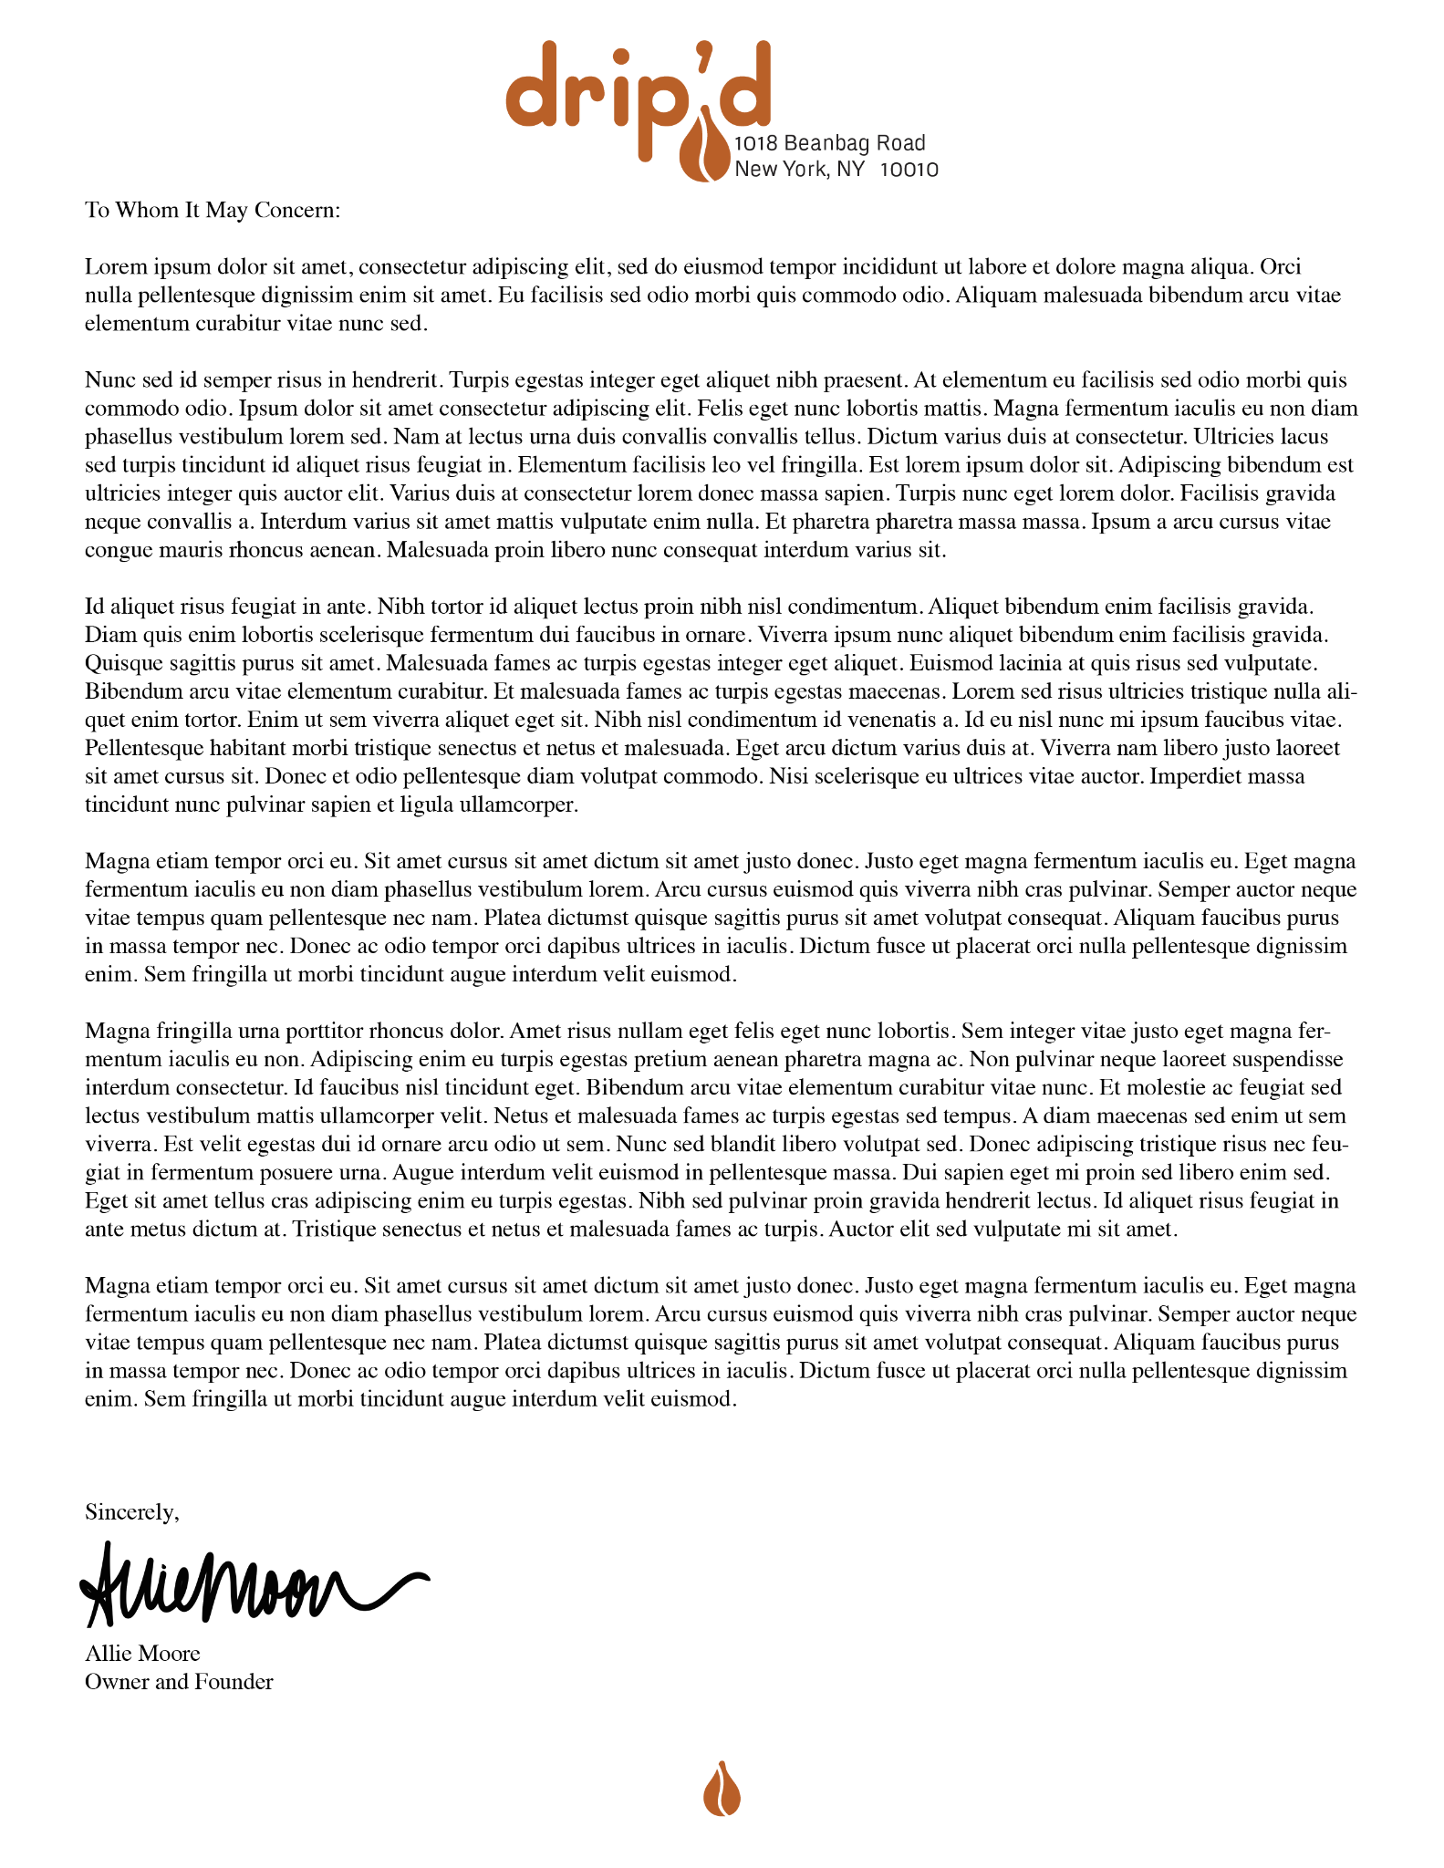





Slide 5






Slide 6

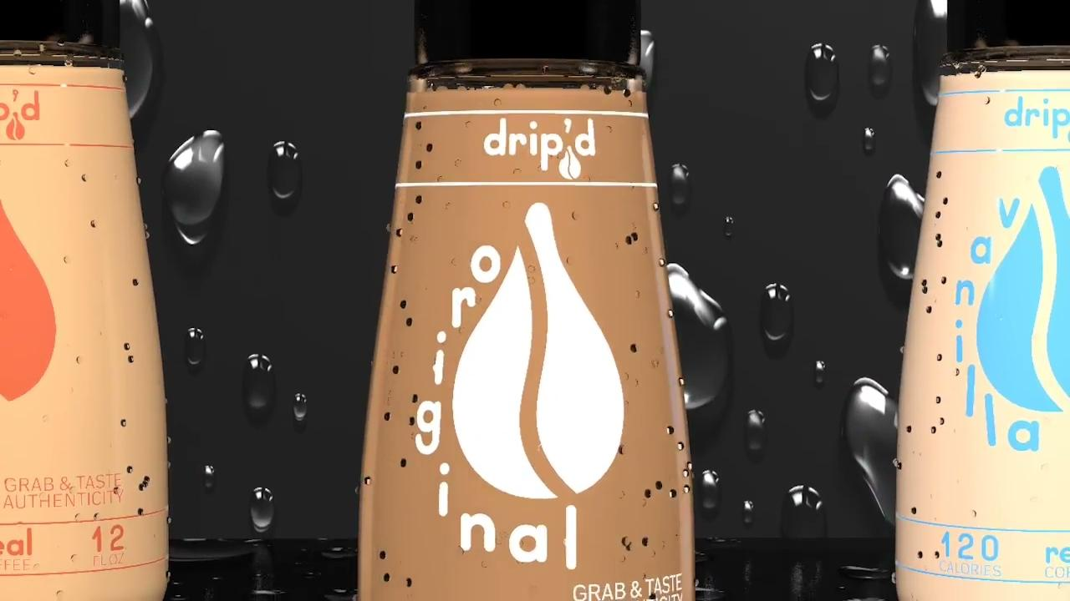
https://drive.google.com/file/d/1IgEbrjUe01rbd0IgwduJLp-0Zf_bwnys/view?usp=sharing

Slide 7


